Slide 1
Manufacturing of Plastic component
UNIT -4 PART II

Slide 2
CONTENTS
4.2.1 INTRODUCTION
4.2.2 TYPES OF PLASTICS
4.2.3 CHARACTERISTICS OF FORMING AND SHAPING PROCESS
4.2.4 MOULDING OF THERMOPLASTICS
4.2.4.1 INJECTION MOULDING
4.2.4.2 BLOW MOULDING
4.2.4.3 ROTATIONAL MOULDING
4.2.4.4 FILM BLOWING
4.2.4.5 EXTRUSION
4.2.4.6 THERMOFORMING
4.2.5 MOULDING OF THERMOSETS
4.2.5.1 COMPRESSION MOULDING
4.2.5.2 TRANSFER MOULDING
4.2.6 BONDING OF THERMOPLASTICS

Slide 3
INTRODUCTION
Plastic manufacturing refers to the process of producing plastic products and components by shaping and molding raw plastic materials. The importance of plastic manufacturing lies in the versatility, affordability, and widespread use of plastic products in various industries and daily life . Plastics have replaced traditional materials in many applications due to their durability, lightweight, and low cost. They are widely used in packaging, construction, automobile, electronics, medical, and many other industries. The widespread use of plastic products has led to an increase in plastic manufacturing, making it a significant contributor to the global economy.
Plastic components refer to a variety of finished plastic products that are used in various industries and applications. They are produced through various manufacturing processes, such as injection molding, extrusion, blow molding, rotational molding, and thermoforming.

Slide 4
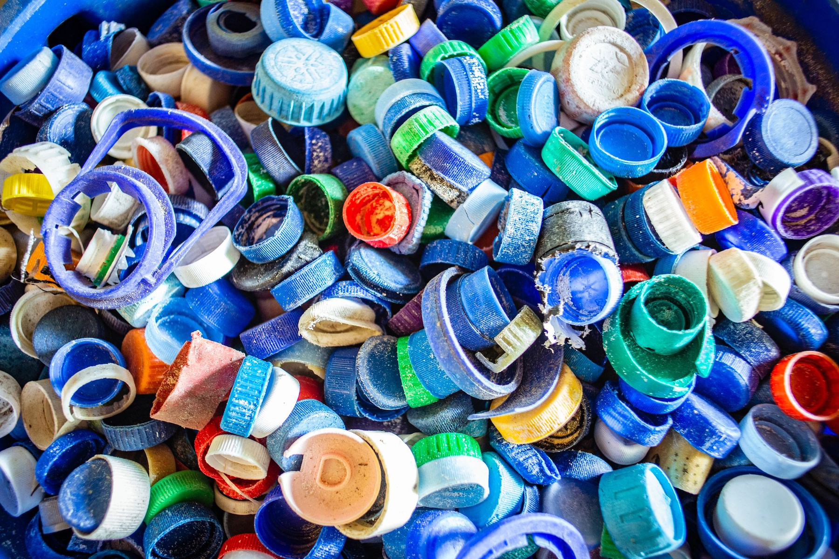
4.2.1 Plastics
Plastics Processing can be defined as converting plastic raw materials into Semi-finished or finished products.
Raw Materials
(Powder/granules)
Semi-finished
or
Finished Products
Processing
It can be molded into required shape with help of pressure or heat or both heat and pressure.
Resin-liquid form of plastics, also raw material for making plastics.
Types of resin: acrylic resin, Polyethylene resin and amino resin, Produced by polymerization process.
Catalysts, Binders and lubricants added with resin to form plastics
Modifiers- To improve the mechanical properties of plastics
Lubricants- To reduce friction during processing, Avoid sticking to mould walls(Oils, Soaps and waxes)
Solvents- Dissolve filler or Plasticizers and allow the processing in fluid state(Alcohol)
Elastomers- To enhance the elastic properties

Slide 5
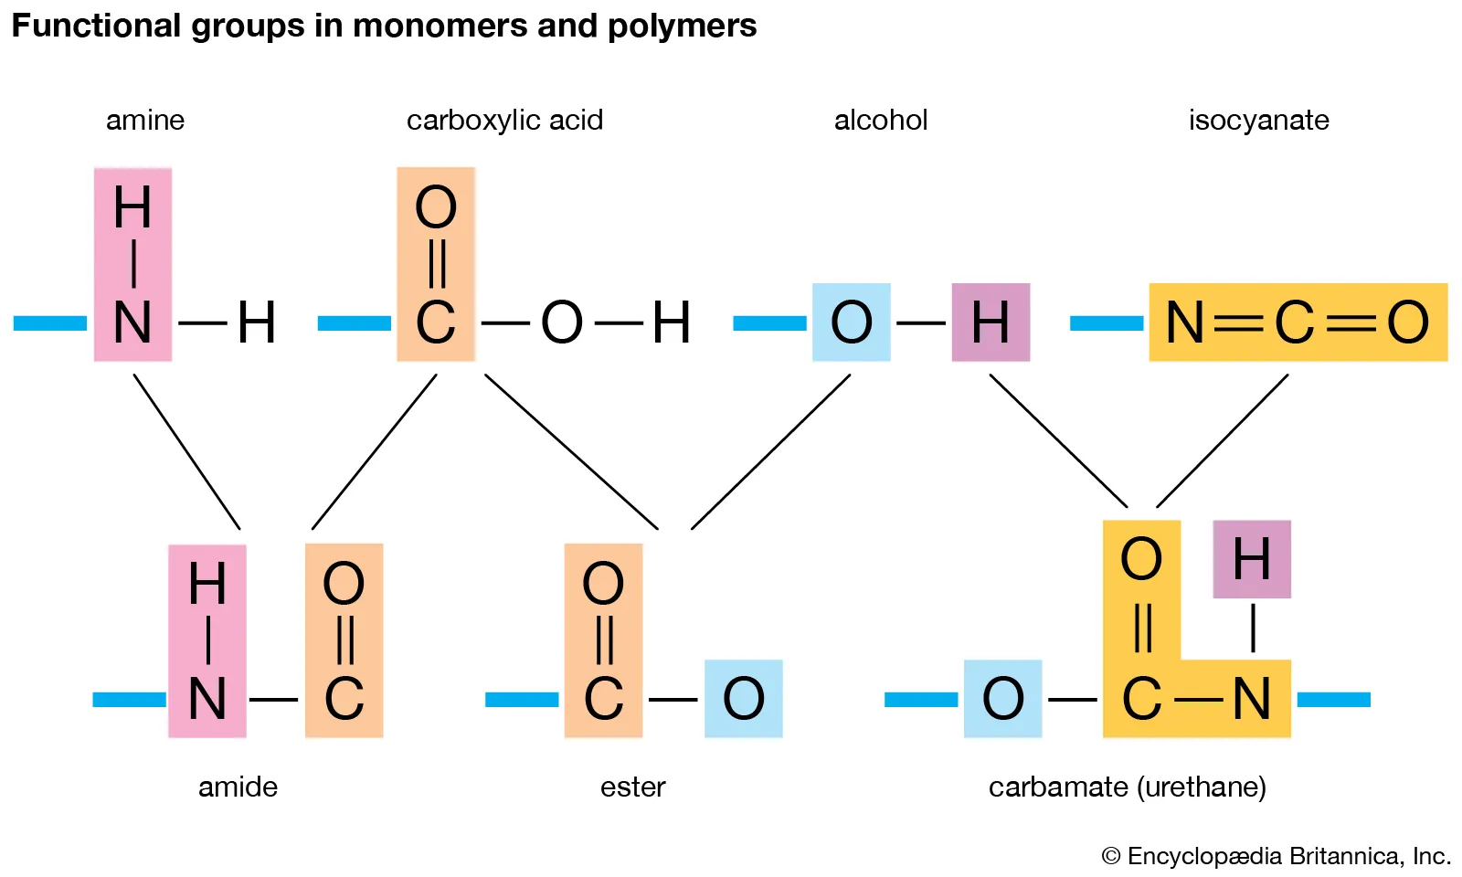
Polymerization Process
A polymer is made up of linking thousands of monomer and thus obtaining large molecule is called polymerization process.
Additives- Plasticizers(liquid form)-Water , Organic solvents and resins
Catalyst-Promote faster and complete Polymerization
Dyes- Impart desired colour

Slide 6
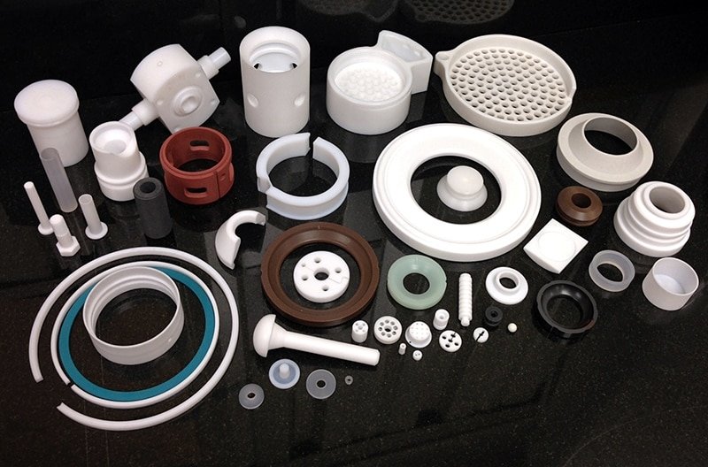
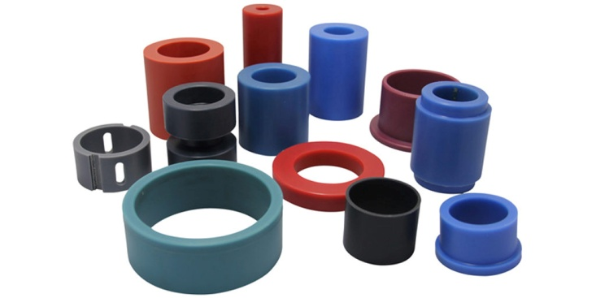
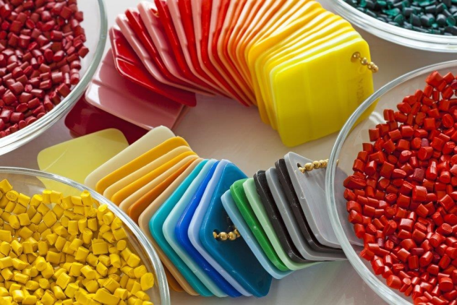
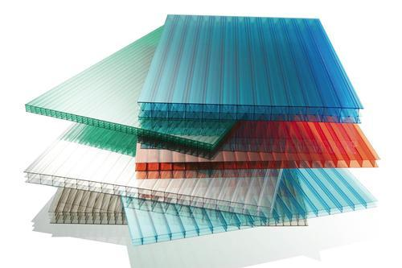
Plastics Used in Manufacturing
Polyethylene (PE) - a lightweight, flexible plastic commonly used in packaging.
Polypropylene (PP) - a strong and heat-resistant plastic used in containers, packaging, and car parts.
Polyvinyl Chloride (PVC) - a versatile plastic commonly used in pipes, wire insulation, and inflatable products.
Polystyrene (PS) - a lightweight plastic used in packaging materials, such as foam peanuts and disposable cutlery.
Polyethylene Terephthalate (PET) - a strong and lightweight plastic commonly used in food packaging and beverage bottles.
Polycarbonate (PC) - a transparent plastic used in safety glasses, CDs, and electronic devices.
Acrylonitrile Butadiene Styrene (ABS) - a strong and heat-resistant plastic used in toys, electrical housings, and automotive parts.
Nylon - a strong and lightweight plastic commonly used in gears, bearings, and electrical components.

Slide 7
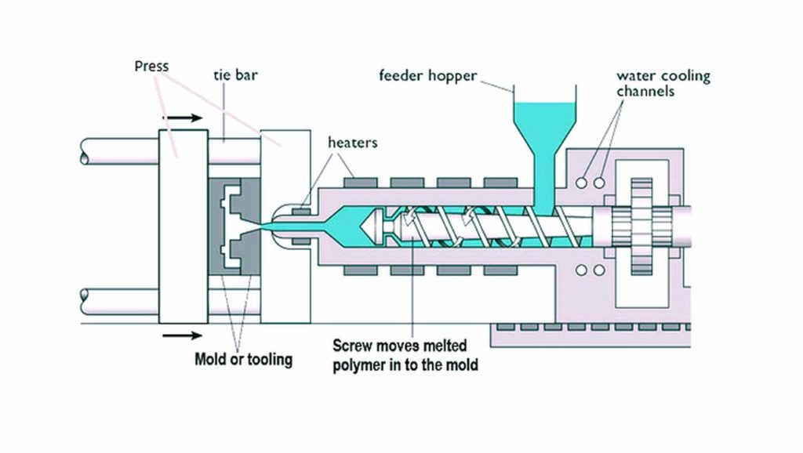
Plastic Processing
Plastics can be machined, cast, formed, and joined with relative ease requiring little post-processing or surface finish operations.
Plastics melt or cure at relative low temperatures
Plastics require less energy to process than metals
Raw materials most commonly are pellets, powders
Also available as sheet, plate, rod, and tubing (produced by extrusion, etc.)

Slide 8
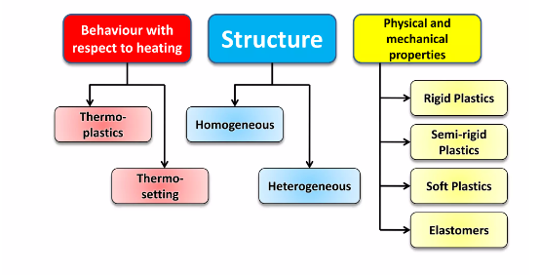
4.2.2 TYPES OF PLASTICS

Slide 9
BEHAVIOUR WITH HEAT:
Thermoplastics- softens on heating, hardens on cooling. Eg- PVC, Polythene.
Thermosetting plastics- do no soften on heating and cannot be remolded. Eg-Polyesters.
BASED ON STRUCTURE:
Homogeneous- composed of the only carbon chain.
Heterogeneous- chain contains carbon, nitrogen, and other elements.
BASED ON PHYSICAL AND CHEMICAL PROPERTIES:
Rigid-high modulus of elasticity.
Semi-rigid-medium modulus of elasticity.
Soft-low modulus of elasticity.
Elastomers deform under pressure and return to their original shape when pressure is removed.

Slide 10
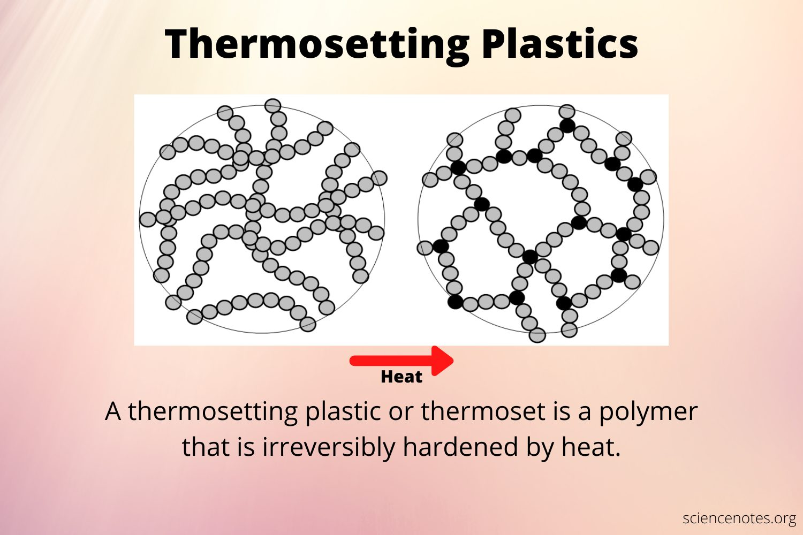
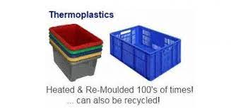
Thermosetting Plastics
Thermo-Plastics
Have separate long and large size molecule arranged side by side.
When thermoplastic are heated it becomes very soft and rehardens on cooling.
During heating the linear bonding links between the molecules are breakup and separated. Relinking takes place on cooling and retain their hardness.
Cellulose nitrates , Ethyl cellulose , Cellulose acetate
Thermosetting- Plastics which are hardened by heat effecting non reversible chemical change. Molecules are formed by condensation polymerization reaction.
All the molecules have three dimensional network and very strong binding force between molecules .
Bakelite , Polyester resin , Silicones , Urea Formaldehyde

Slide 11
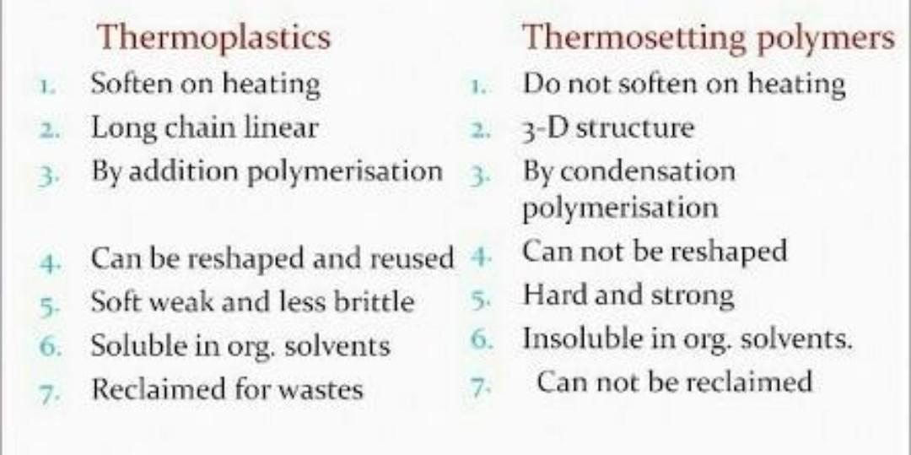
DIFFERENCE BETWEEN THERMOPLASTIC AND THERMOSETTING

Slide 12
4.2.3 FORMING AND SHAPING PROCESSES
Process
Characteristics
Extrusion
Long, uniform, solid or hollow complex cross-sections; high production rates; low tooling costs; wide tolerances.
Complex shapes of various sizes, eliminating assembly; high production rates;
costly tooling; good dimensional accuracy.
Large parts with high stiffness-to-weight ratio; less expensive tooling than in injection molding; low production rates.
Hollow thin-walled parts of various sizes; high production rates and low cost for making containers.
Large hollow shapes of relatively simple shape; low tooling cost; low production
rates.
Shallow or relatively deep cavities; low tooling costs; medium production rates. Parts similar to impression-die forging; relatively inexpensive tooling; medium production rates.
More complex parts than compression molding and higher production rates; some scrap loss; medium tooling cost.
Simple or intricate shapes made with flexible molds; low production rates.
Injection molding
Structural foam molding
Blow molding
Rotational molding
Thermoforming Compression molding
Transfer molding
Casting
Processing of composite materials Long cycle times; tolerances and tooling cost depend on process.

Slide 13
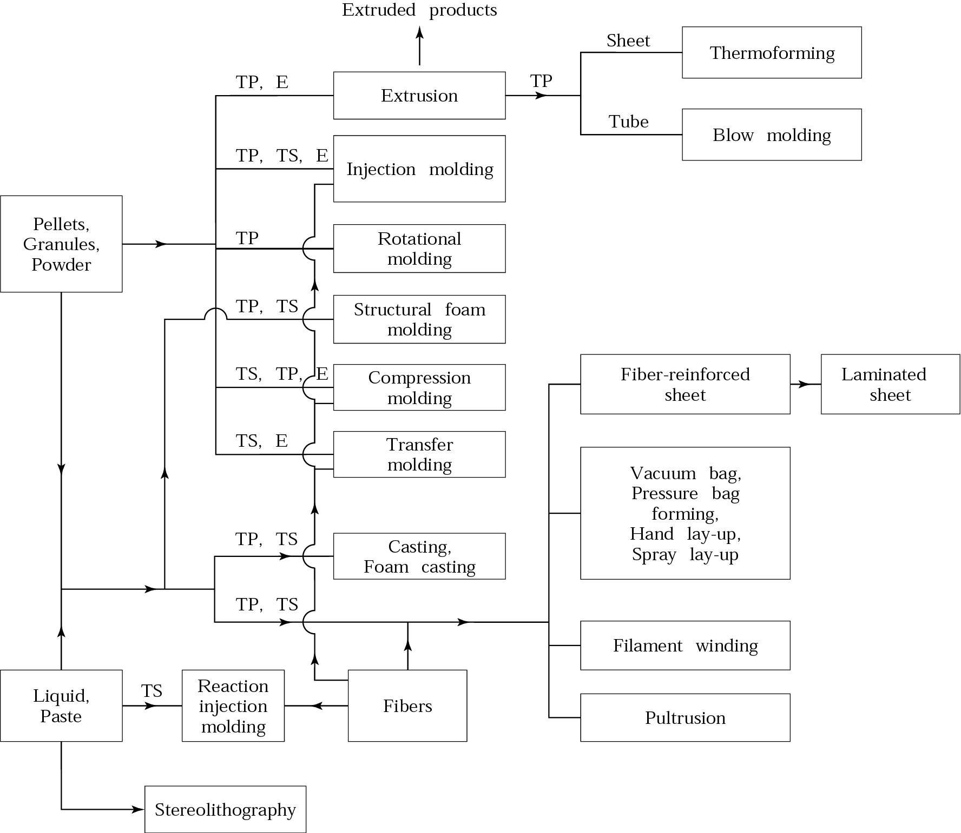
.

Slide 14
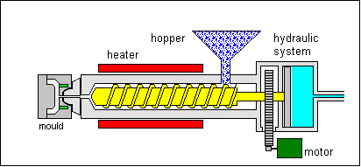
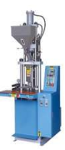
4.2.4.1 Injection moulding
Horizontal molding machine
Process
Plastic powder or granules are fed from a hopper into a hollow steel barrel which usually contains a rotating screw.
Vertical molding machine
The barrel is surrounded by a jacket of heaters which melt the plastic material as it is carried along the barrel by the screw towards the mould. This part of the process is similar to the heating and compacting stages in the extrusion process. The screw is forced back as the melted plastic collects at the end of the barrel. Once a sufficient charge of melted plastic has accumulated a hydraulic ram forces the screw forward injecting the thermoplastic through a sprue into the mould cavity. The diagram (left) shows a typical injection moulding machine. This one is capable of exerting forces of up to 250 tonnes. Pressure is kept on the mould until the plastic has cooled sufficiently for the mould to be opened and the component ejected.

Slide 15
Injection molding machines have many components and are available in different configurations, including a horizontal configuration and a vertical configuration. However, regardless of their design, all injection molding machines utilize a power source, injection unit, mold assembly, and clamping unit to perform the four stages of the process cycle
Injection moulding is a highly automated production process for producing large quantities of identical items. Granulated or powdered thermoplastic material is heated, melted and then forced under pressure into a mould. Once in the mould, the material cools, forming a component that takes on the shape of the mould cavity.
Very widely used. High automation of manufacturing is standard practice. Thermoplastic or thermoset is heated to plasticate in a cylinder at a controlled temperature, then forced under pressure through a nozzle into sprue, runners, gates, and cavities of mould. The resin undergoes solidification rapidly. The mould is opened, and the part is ejected, Injection Moulding is growing in the making of glass-reinforced parts. High production runs, low labour costs, high reproducibility of complex details, and excellent surface finish are the merits.
LIMITATION:
High initial tool and die costs; not economically practical for small runs.

Slide 16
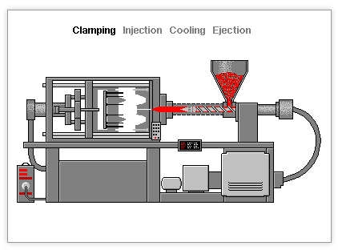
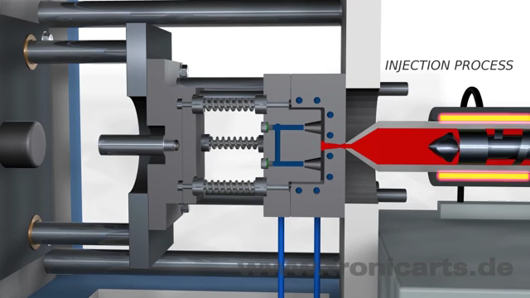
Injection moulding

Slide 17
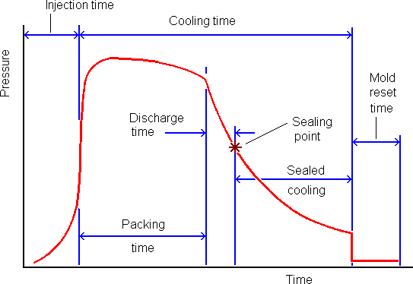
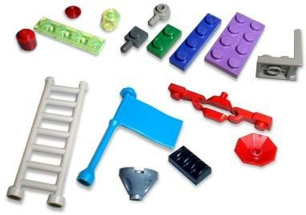
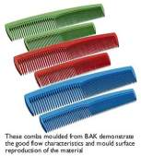

Plastic Injection Molding Cycle Time Breakdown Cycle Time Breakdownlastic Injection Molding Cycle Time Breakdown
INJECTION MOULDED PRODUCTS
.
.

Slide 18
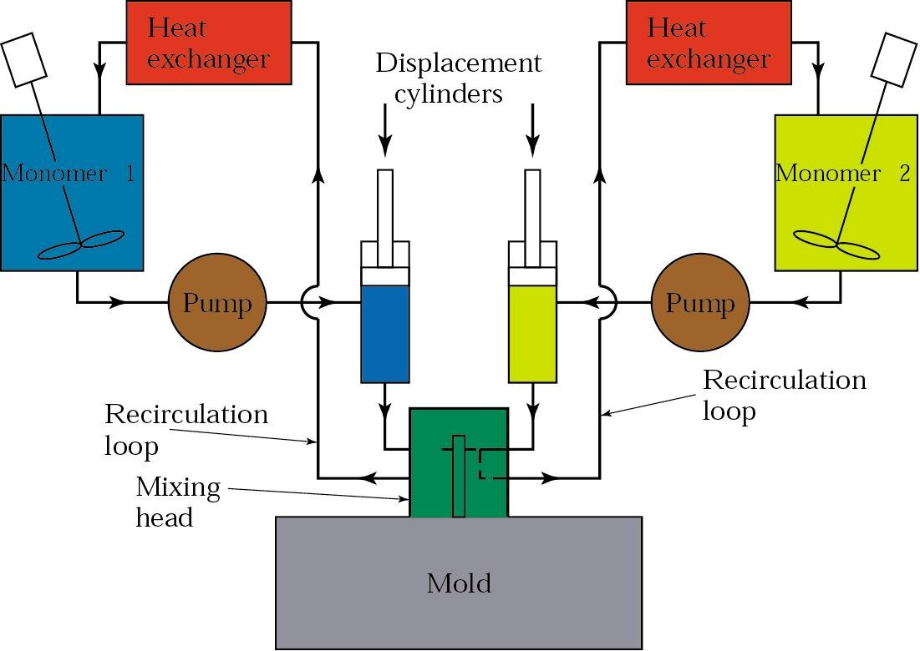
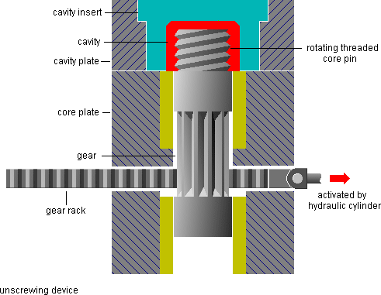
Injection Molding Die Mechanisms Unscrewing Core
Reaction Injection Moulding
.
Large parts
Low tooling cost
Car bumpers are good examples for this process

Slide 19
Injection Moulding Capabilities abilities
High production rates
Good dimensional control
5-60 second cycle times (or several minutes for thermoset
materials)
Molds with multiple cavities, made of tool steels (2 million cycles), aluminum (10,000 cycles), etc.
Mold costs up to $20-200K
Machines are usually horizontal with clamping forces 0.9- 2.2 MN (100-250 tons)
100 ton machines cost $60-90K
300 ton machines cost $85-140K

Slide 20
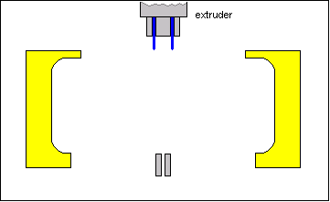
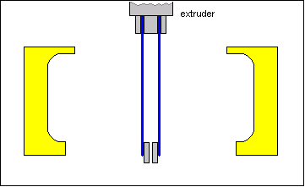
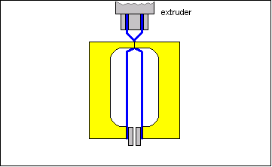
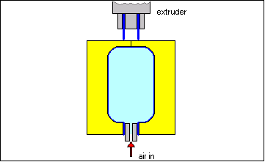
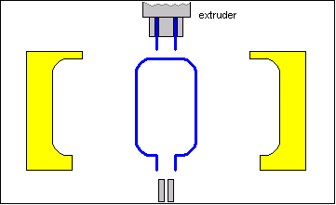
4.2.4.2 BLOW MOULDING
Extrusion blow moulding is an automated process that is used extensively to make bottles and other lightweight, hollow parts from thermoplastic materials.
Process
The cycle starts with the mould open (1). A hollow length of plastic, called a parison, is extruded down between two halves of the mould (2).
The mould closes and compressed air is blown into the inside of the parison which inflates it, pushing the soft plastic hard against the cold surfaces of the mould (3). The plastic is cooled by the mould, causing it to harden quickly (4). The mould is then opened, the moulding ejected and the waste (called flash) is trimmed off with a knife (5).
(1)
(2)
(3)
(4)
(5)
An extruded parison tube of heated thermoplastic is positioned between two halves of an open split mould and expanded against the sides of the closed mould via air pressure. The mould is opened and the part ejected. Low tool and die costs, rapid production rates, and ability to mould fairly complex hollow shapes in one piece.
LIMITATION: Generally limited to hollow or tubular parts; some versatile mould shapes, other than bottles and containers.

Slide 21
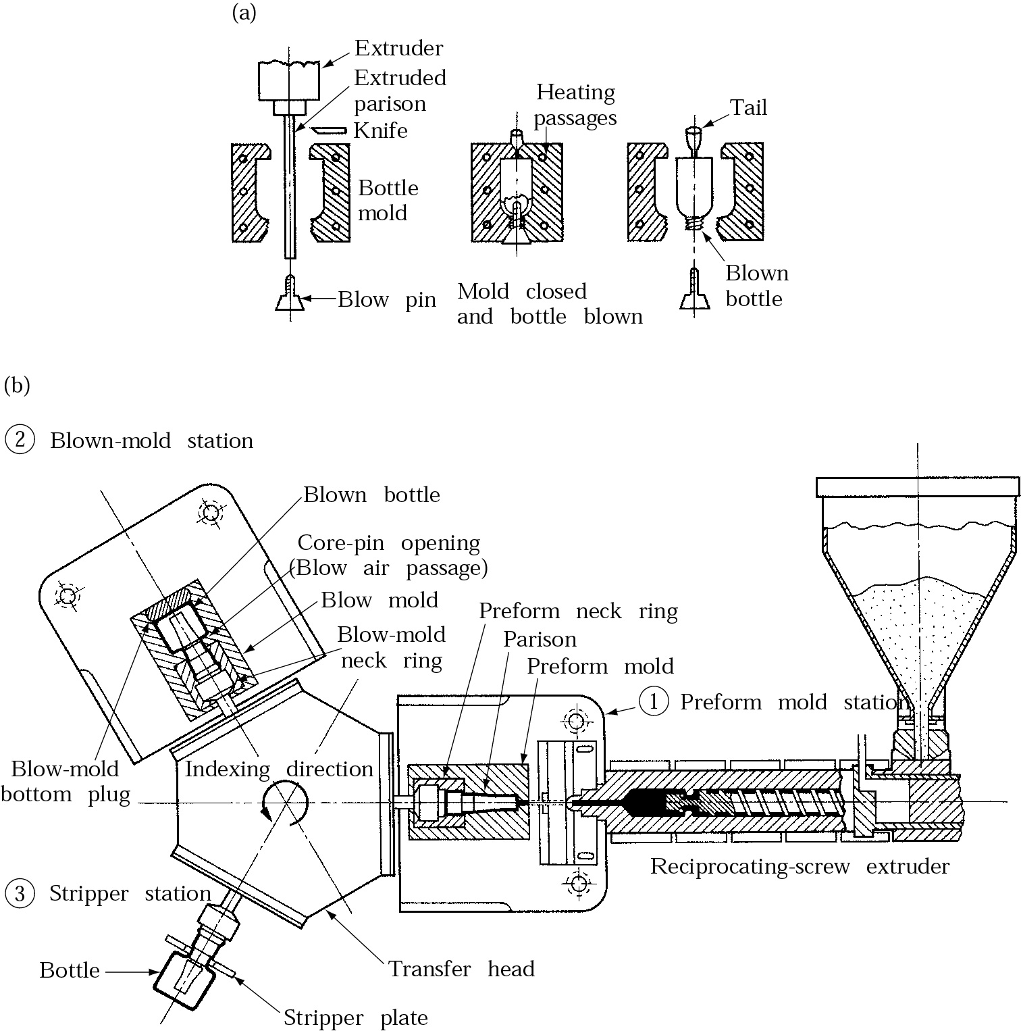
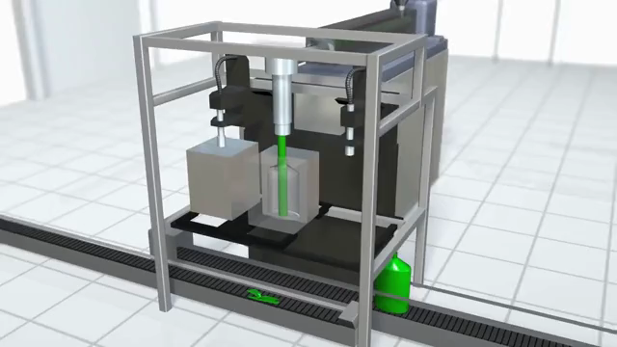
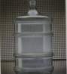
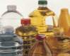
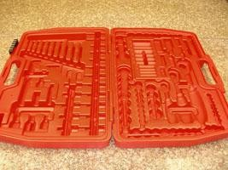
Schematic illustrations of (a) the blow-molding process for making plastic beverage bottles, and (b) a three- station injection blow-molding machine.

Slide 22
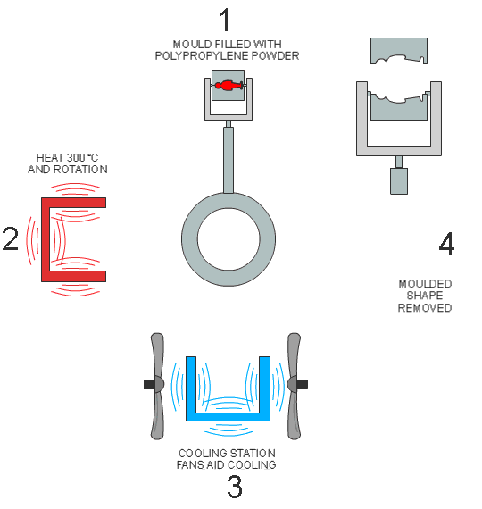
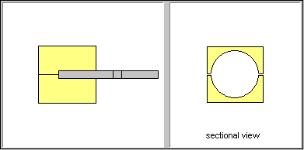
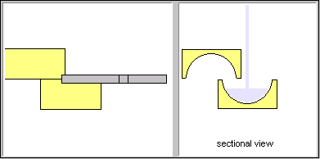
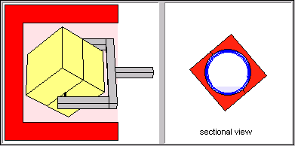
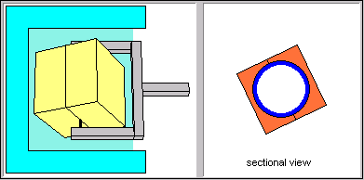
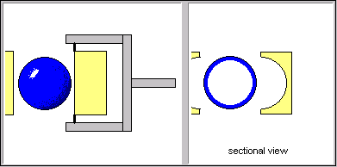
4.2.4.3 ROTATIONAL MOULDING
Rotational moulding is a process used mainly to manufacture hollow-shaped products such as footballs, road cones and storage tanks up to 3m³ capacity.
A measured weight of thermoplastic is placed inside a cold mould like the one below (Station 1). The mould is then closed and moved into an oven chamber (Station 2) where it is heated to a temperature of 230-400°C whilst being rotated simultaneously around both vertical and horizontal axes. Rotational speeds are usually between 2 and 20 r.p.m
.

Slide 23

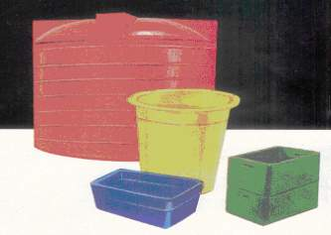
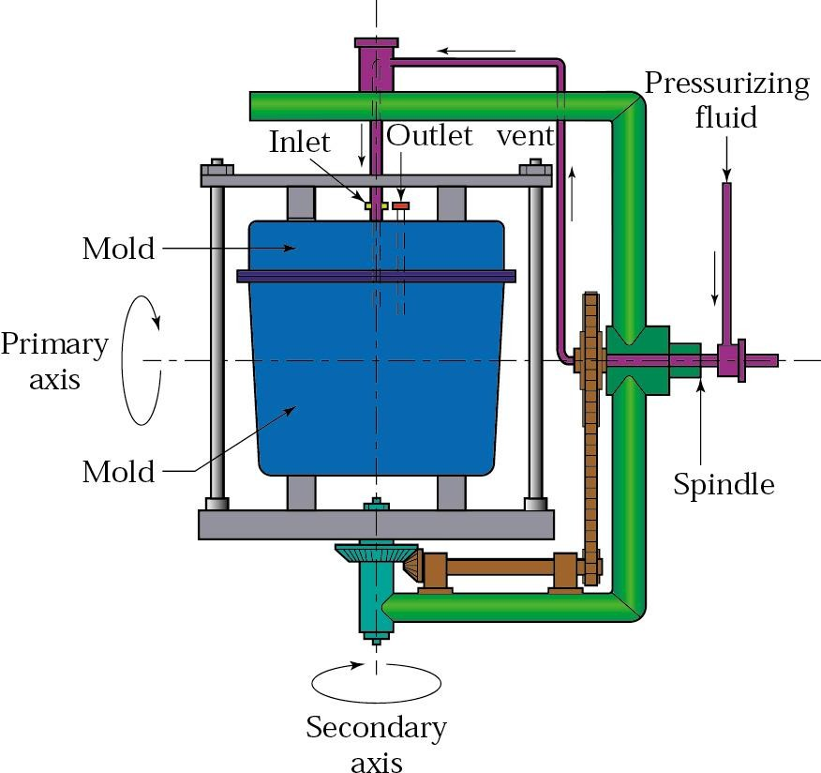
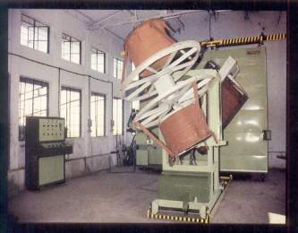
DESCRIPTION:
A predetermined amount of powdered thermoplastic material is poured into mould; mould is closed, heated, and rotated in the axis of two planes until contents have fused to the inner walls of mould; mould is then opened and part is removed. Low mould cost, large hollow parts in one piece can be produced, and moulded parts are essentially isotropic in nature.
LIMITATIONS:
Limited to hollow parts; production rates are usually slow.
.
Rotational Mouldings Products:

Slide 24
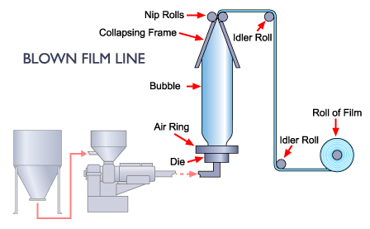
4.2.4.4 FILM BLOWING
Blown film extrusion is the most common process for the production of continuous films that are used primarily for packaging. The first step in the process is to melt the plastic in the extruder, the molten polymer then enters an annular die head and is formed into a tube of plastic material.
After exiting the die the film tube, which is still in a plastic state, is pulled upwards by nip rollers. At the same time compressed air is blown into the film tube to achieve the desired film thickness and width. Chilled air is blown on the outside of the tube.

Slide 25
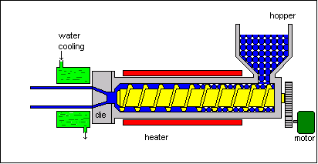
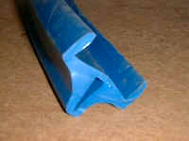
4.2.4.5 EXTRUSION
This process can be compared to squeezing toothpaste from a tube. It is a continuous process used to produce both solid and hollow products that have a constant cross-section: for example, a window frame, hose pipe, curtain track, garden trellis.
This extrusion is part of a window seal made from thermoplastic elastomer (TPE).
Widely used for continuous production of film, sheet, tube, and other profiles; also used in conjunction with blow moulding . Thermoplastic moulding compound is fed from a hopper to a screw pump where it is heated to plasticate then pumped out through the shaping orifice (die) to achieve desired cross section. Production lines require input and takeoff equipment that can be complex. Low tool cost, numerous complex profile shapes possible, very rapid production rates, can apply coatings or jacketing to core materials (Such as wire).
LIMITATIONS:
Usually limited to sections of uniform cross section

Slide 26
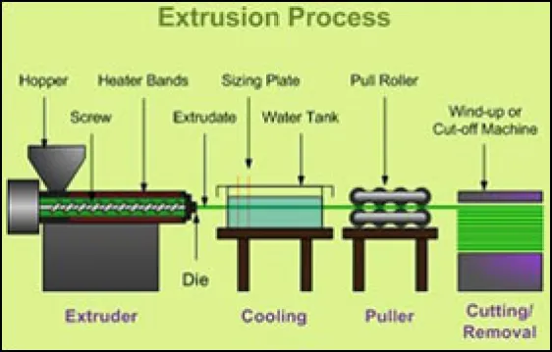
Plastic Extrusion
Extrusion is a process used to create objects of a fixed cross-sectional profile by pushing material through a die of the desired cross-section.
Plastics extrusion is a normally high volume manufacturing process where a polymer material, enriched with the desired additives, is melted and formed in a continuous process. The raw material (polymer) in the form of granulates, is gravity fed into the hopper and through the feed throat, drops on a rotating screw.

Slide 27
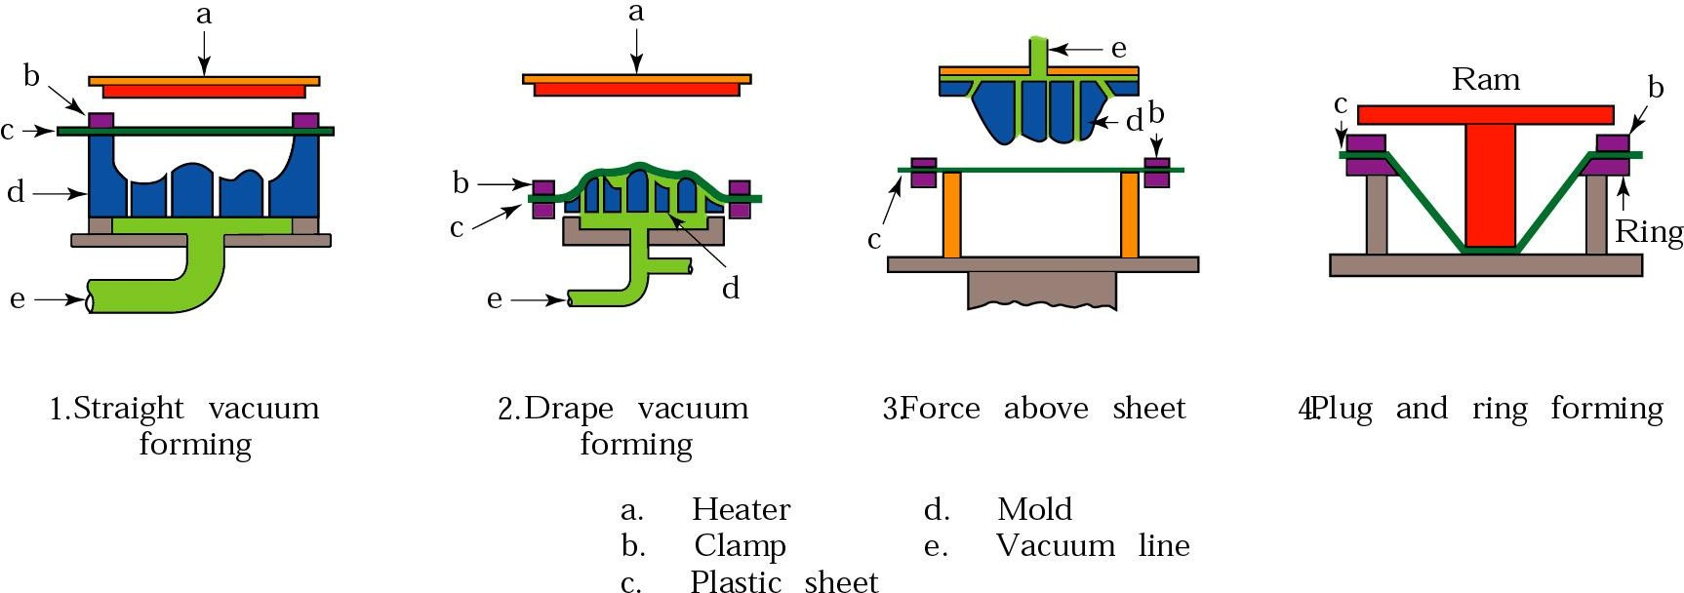
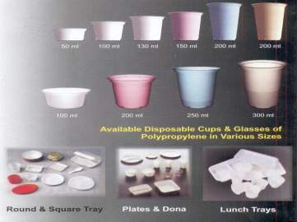
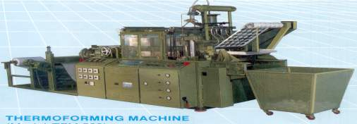
4.2.4.6 THERMOFORMING
.
Thermo Formed Parts
Heat-softened thermoplastic sheet is positioned over male or female mould; air is evacuated between sheet and mould, forcing sheet to conform to contour of mould. Variations are vacuum snapback, plug assist, drape forming, etc. Tooling costs are generally low, large part production with thin sections possible, and often comes out economical for limited part production.
LIMITATIONS:
Limited to parts of simple configuration, high scrap, and limited number of materials from which to choose

Slide 28
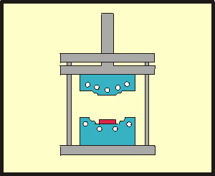
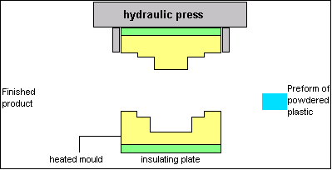
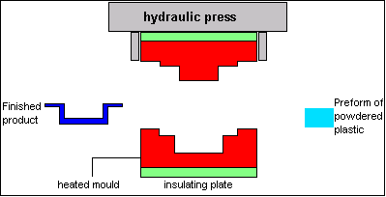


4.2.5.1 COMPRESSION MOULDING
This is, historically, the oldest commercial plastics moulding process and is mainly used to make products from thermosetting materials. A combination of heat and pressure is used to change the material's form and chemical structure.
Materials
Typical thermosetting plastics used in compression moulding are urea formaldehyde and phenol formaldehyde. These materials are different from
thermoplastics as they cannot be reheated and reshaped because a chemical change, called polymerisation, has taken place. Generally thermosets tend to be harder, stiffer and more resistant to the effects of heat and chemical attack than are thermoplastic materials.

Slide 29



Thermoset compound, usually preformed, is positioned in a heated mould cavity; the mould is closed (heat and pressure are applied) and the material flows and fills the mould cavity. Heat completes polymerization and the part is ejected. The process is sometimes used for thermoplastics, e.g. Vinyl phonograph records. Little material waste is attainable; large, bulky parts can be moulded; process is adaptable to rapid automation.
LIMITATION:
Extremely intricate parts containing undercuts, side draws, small holes, delicate inserts, etc.; very close tolerances are difficult to produce.
Time consuming process.
.
Compression Moulded products:

Slide 30

4.2.5.2 TRANSFER MOULDING
Transfer Molding (Resin Transfer Molding) is a process in which a pre-weighed amount of a polymer is preheated in a separate chamber (transfer pot) and then forced into a preheated mold through a sprue, taking a shape of the mold cavity and performing curing due to heat and pressure applied to the material.
The method is capable to produce more complicated shapes than Compression Molding but not as complicated as Injection Molding.

Slide 31
Advantages of Plastic Component Manufacturing
Cost-effectiveness: Plastic components are typically less expensive to manufacture compared to metal parts.
Lightweight: Plastic parts are lighter in weight, making them ideal for use in applications where weight reduction is a priority.
Design Flexibility: Plastic components can be molded into complex shapes, making them ideal for use in applications requiring intricate designs.
Durability: Plastic components are resistant to corrosion, rust and other forms of degradation, making them ideal for use in harsh environments.
Versatility: Plastic parts can be manufactured in a wide range of colors, finishes, and materials to meet specific application requirements.
Recyclability: Plastic components can be easily recycled, reducing waste and helping to promote sustainability.
Electrical insulation: Plastic parts offer good electrical insulation properties, making them ideal for use in electrical applications.

Slide 32

Challenges in Plastic Component Manufacturing
Tooling costs: The cost of creating molds and dies for plastic component manufacturing can be high, especially for complex shapes.
Material properties: Plastic properties can vary widely, making it challenging to predict performance and achieve consistent results.
Surface finish: Achieving a high-quality surface finish on plastic components can be difficult, especially for parts with complex shapes or intricate details.
Shrinkage: Plastic components can shrink during the cooling process, which can result in dimensional inaccuracies or warping.
Processing conditions: Plastic component manufacturing requires precise control over temperature, pressure, and cooling rates, making it challenging to achieve consistent results.
Quality control: Maintaining consistent quality can be difficult, especially for parts with complex shapes or intricate details.
Environmental impact: Plastic component manufacturing can have negative environmental impacts, such as emissions of harmful chemicals and the use of non-renewable resources.
Recycling and disposal: The disposal of plastic components can be a challenge, especially if they are not properly recycled.

Slide 33

Plastic components have a wide range of applications,
Packaging: Plastic containers, bags, and films are used in the packaging of food, consumer goods, and industrial products.
Construction: Plastic components, such as pipes and windows, are used in construction and building materials.
Automotive: Plastic components, such as dashboards, bumpers, and fuel tanks, are used in the automotive industry.
Electronics: Plastic components, such as casings and connectors, are used in the electronics industry.
Medical: Plastic components, such as medical devices and packaging, are used in the medical industry.

Slide 34

Grades of plastics in daily uses

Slide 35


